Slide 1
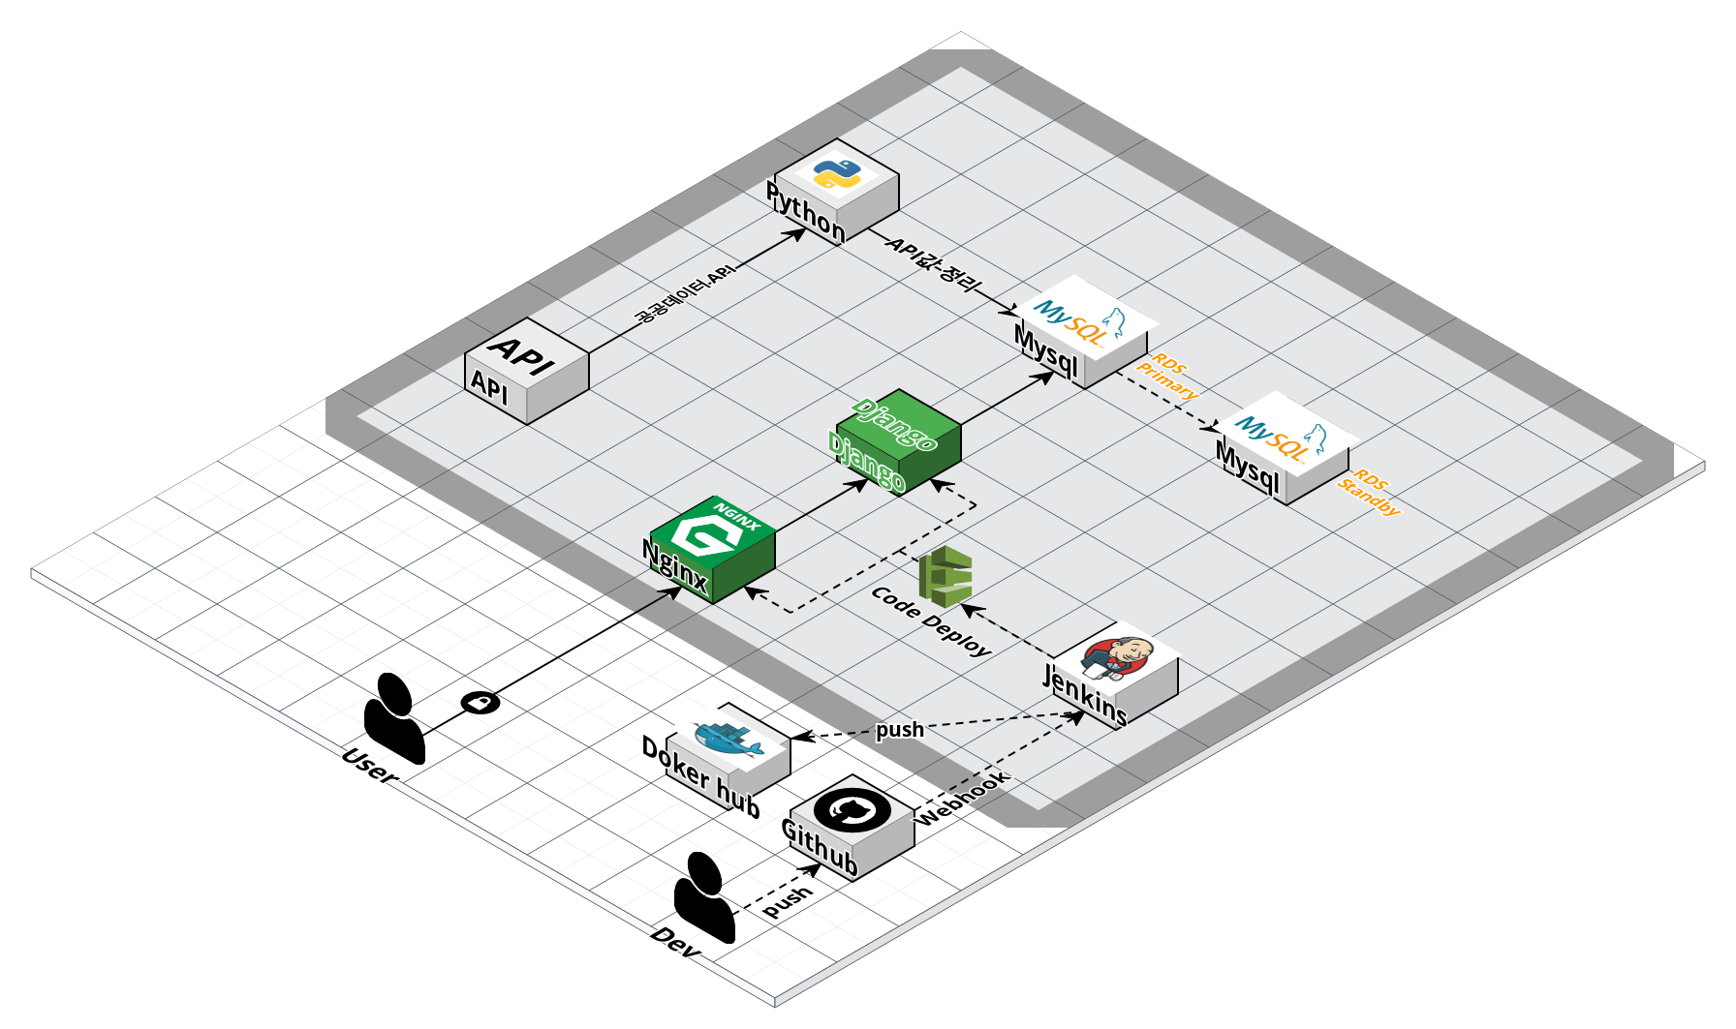

Slide 2
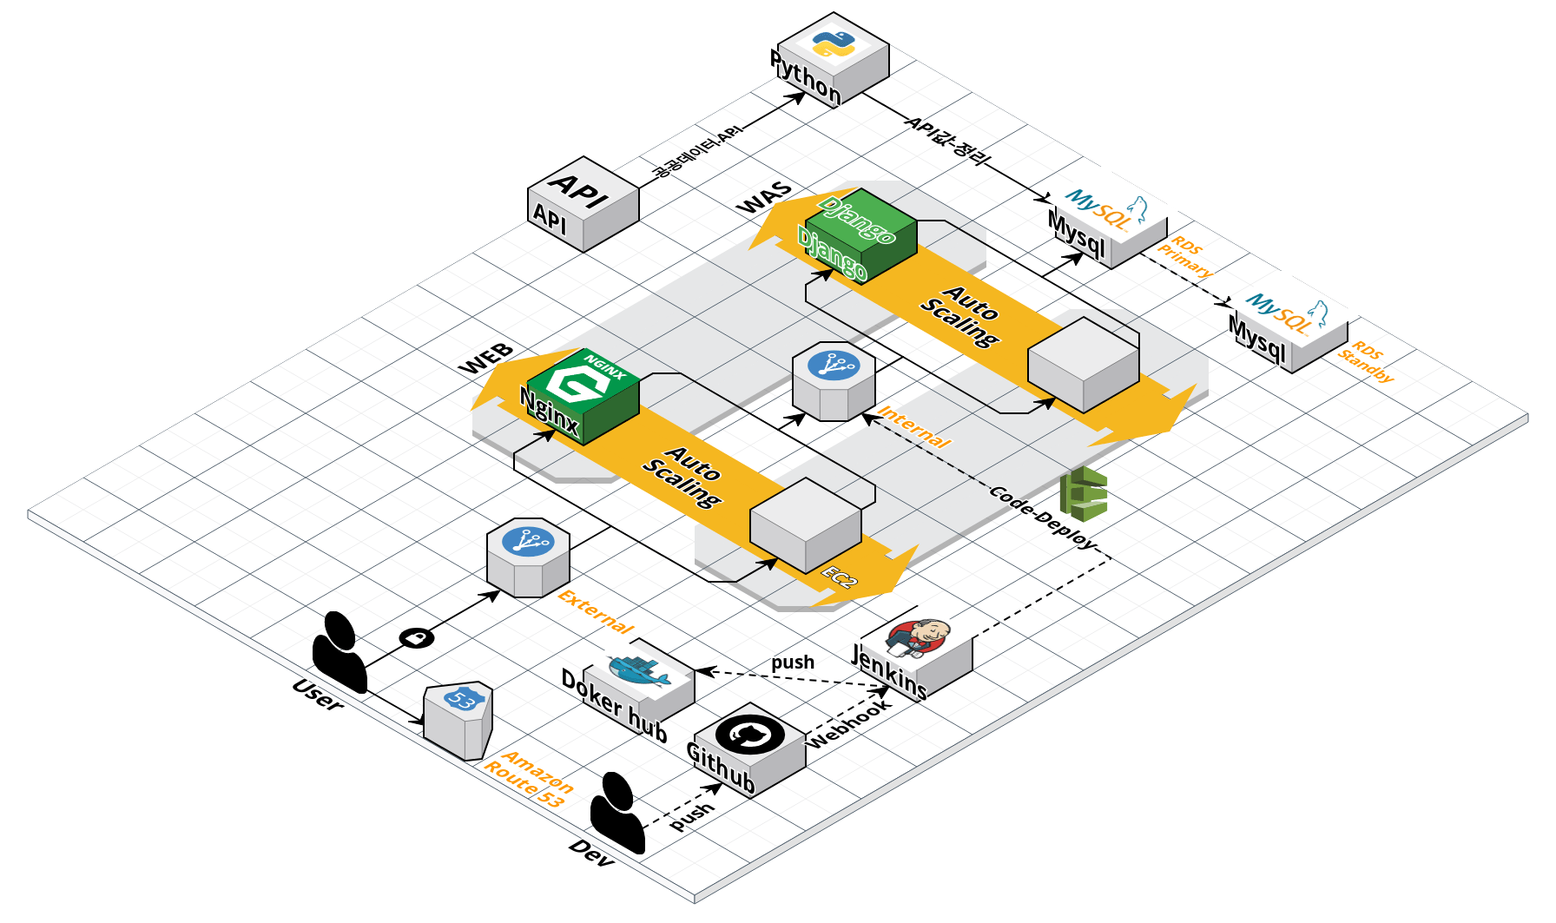

Slide 4









AWS ec2
Webhook
Jenkins
AWS ec2
AWS ec2
Build and test
Deploy
Gunicorn
Aws code deploy
Github repository push
AWS rds

Slide 5

API 호출
데이터 가공 후 저장
AWS rds

Slide 6
